Slide 1



SUMMER TRAINING
MongoDB
Modern Data Management for Developers
National Telecommunication Institute
Ministry of Communications and Information Technology

Slide 2



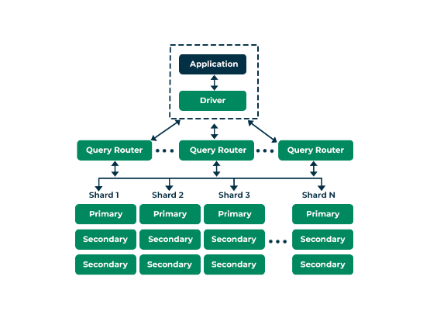
COURSE ROADMAP
01. CRUD Operations
02. Data Modeling & Schema
03. Aggregation & Optimization
04. Indexes
05. Backup & Restore

Slide 3
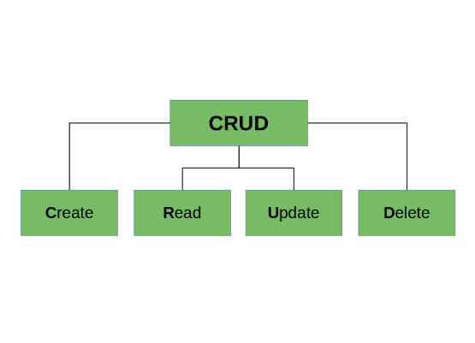
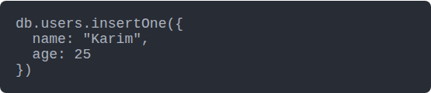
CRUD: CREATE OPERATION
insertOne()
Adds a single document to a collection.
MongoDB automatically adds a unique _id if you don't provide one.

Slide 4
QUERY COMPARISON OPERATORS
Operator | Meaning | Practical Example
$gt / $gte | Greater than / or equal | { price: { $gt: 100 } }
$lt / $lte | Less than / or equal | { age: { $lt: 18 } }
$ne | Not equal to | { status: { $ne: "deleted" } }
$in | Matches any in array | { tags: { $in: ["tech", "ai"] } }

Slide 5



ADVANCED QUERYING
$or
$nor
Joins query clauses with a logical OR.
Inverse of OR. Neither condition matches.
$elemMatch
$all
Matches docs with at least one array element that matches all criteria.
Matches arrays that contain all specified elements.

Slide 6
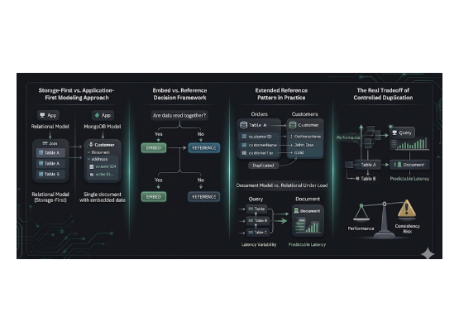
DATA MODELING STRATEGIES
Embedded Documents
Store related data in a single document (One-to-One / One-to-Few).
•
✔ High Performance (Single Read)
•
✘ Document size limit (16MB)
Use for: User Addresses, Product Specs.

Slide 7

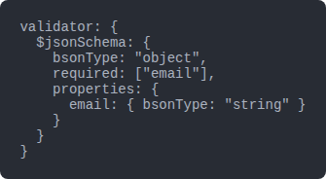
SCHEMA VALIDATION
Enforcing Quality
MongoDB is "Schema-less," but in production, we need rules.
Validators allow us to define JSON Schemas for collections to ensure:
•
Required fields are present.
•
Data types are correct.
•
Values fall within ranges.

Slide 8







THE AGGREGATION PIPELINE
$match
$group
$project
Filters documents (like WHERE in SQL).
Aggregates data (like GROUP BY).
Reshapes documents (Select fields).

Slide 9



PIPELINE STAGES IN ACTION
$sort
$limit
$unwind
Orders documents.
Passes only N docs.
Flattens arrays.
$lookup
$count
$addFields
Left outer join.
Returns doc count.
Adds new fields.

Slide 10
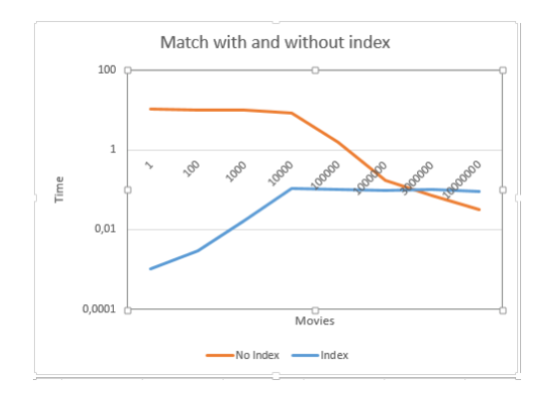
INDEXES & PERFORMANCE
Why Index?
Without an index, MongoDB must perform a Collection Scan (reading every document).
Common Types:
•
Single Field: Index on one key.
•
Compound: Index on multiple keys.
•
TTL: Automatically deletes docs after time.

Slide 11

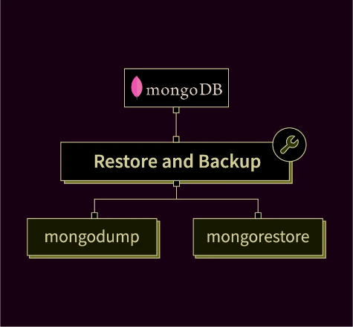


Q&A
Any Questions?
Backup Essentials
mongodump --db myDb mongorestore --db myDb /dump
Course Finished Thank you for your participation!

Slide 12






IMAGE SOURCES
https://www.nti.sci.eg/images/logo.png
Source: www.nti.sci.eg
https://media.geeksforgeeks.org/wp-content/uploads/20231107111719/MongoDB-Architecture.png
Source: www.geeksforgeeks.org
https://miro.medium.com/0*jThgXou1RZ6hPiq6.jpg
Source: coderiksenthil.medium.com
https://cdn.educba.com/academy/wp-content/uploads/2018/11/JSON-vs-BSON.jpg
Source: www.educba.com
https://media.geeksforgeeks.org/wp-content/uploads/20220523175518/CRUDOperations.png
Source: www.geeksforgeeks.org
https://marionoioso.com/wp-content/uploads/2026/02/MongoDB-Data-Modeling-The-Truth-About-Relationships-Data-Duplication-and-Performance.jpg
Source: marionoioso.com

Slide 13



IMAGE SOURCES
https://cdn.prod.website-files.com/6717800cb1e973b8fc433b03/6717800cb1e973b8fc434341_670199f49cd01719054e968c_T8LWGtLjMYc0avFy.gif
Source: www.mydbops.com
https://i.sstatic.net/m2tBs.png
Source: stackoverflow.com
https://www.scaler.com/topics/images/mongodb-restore-command_thumbnail.webp
Source: www.scaler.com

